Slide 1
Software Craftsmanship
Cédric HARTLAND

Slide 2
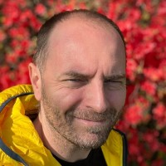
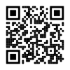
About
Cédric HARTLAND
Ph.D. in AI – UPSud, INRIA, CNRS
Courses in AI & CS since 20
2005 – 2010 – Researcher / Lecturer
2010 – 2017 – CAST
2017-2019 – Futurmaster
2019-2022 – Talentsoft
2022 – PlayPlay
2022+ - Thales Digital Factory
https://github.com/gigacool/craftsmanship-course

Slide 3
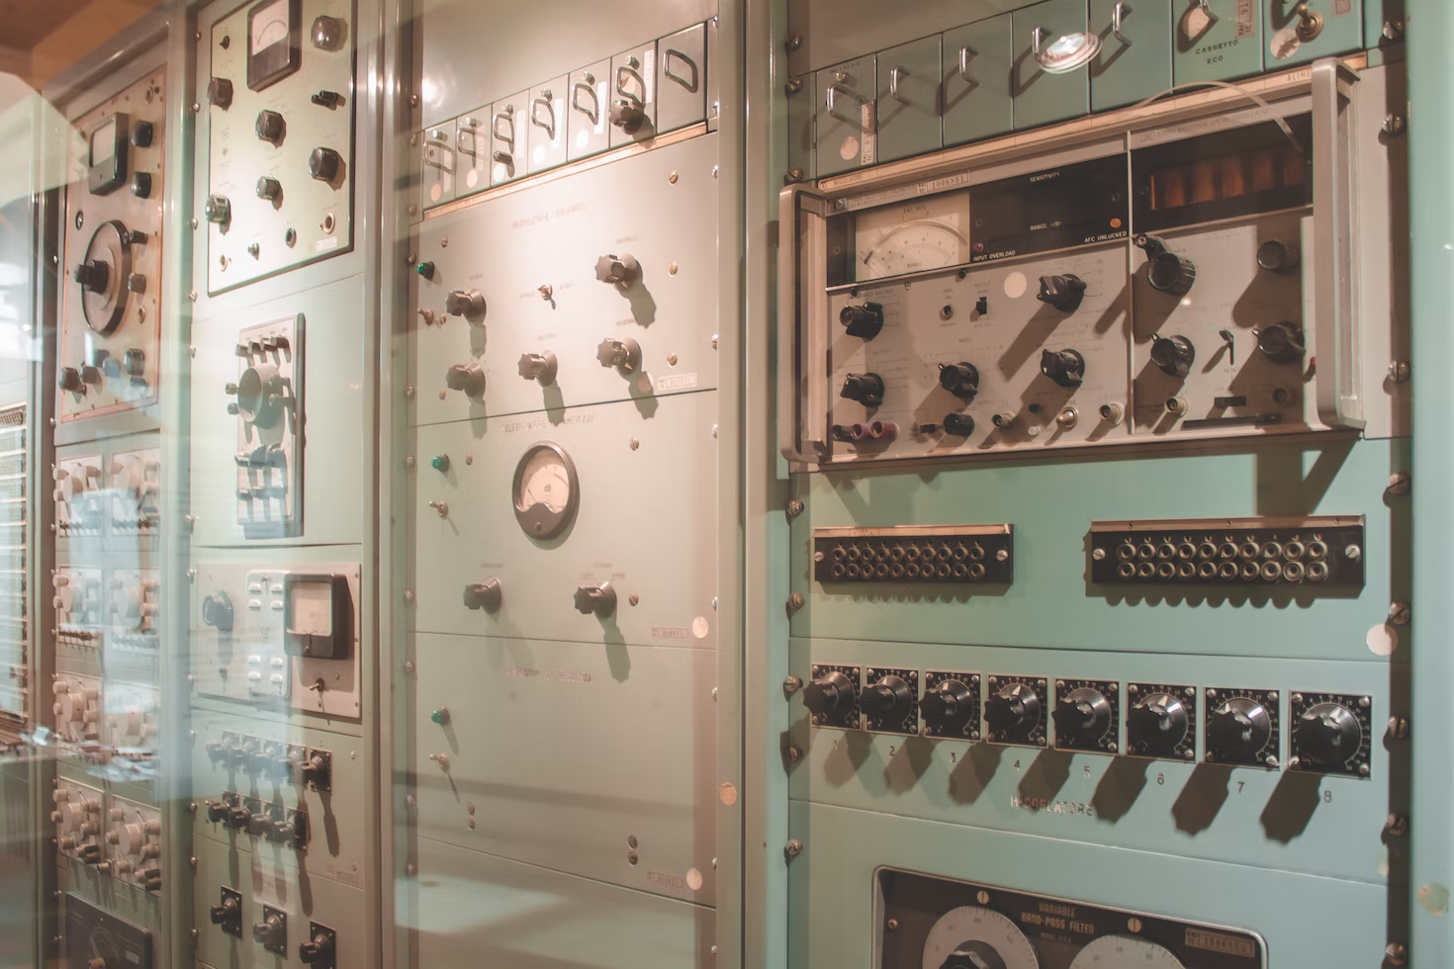


Software crisis, engineering & crafts

Slide 4
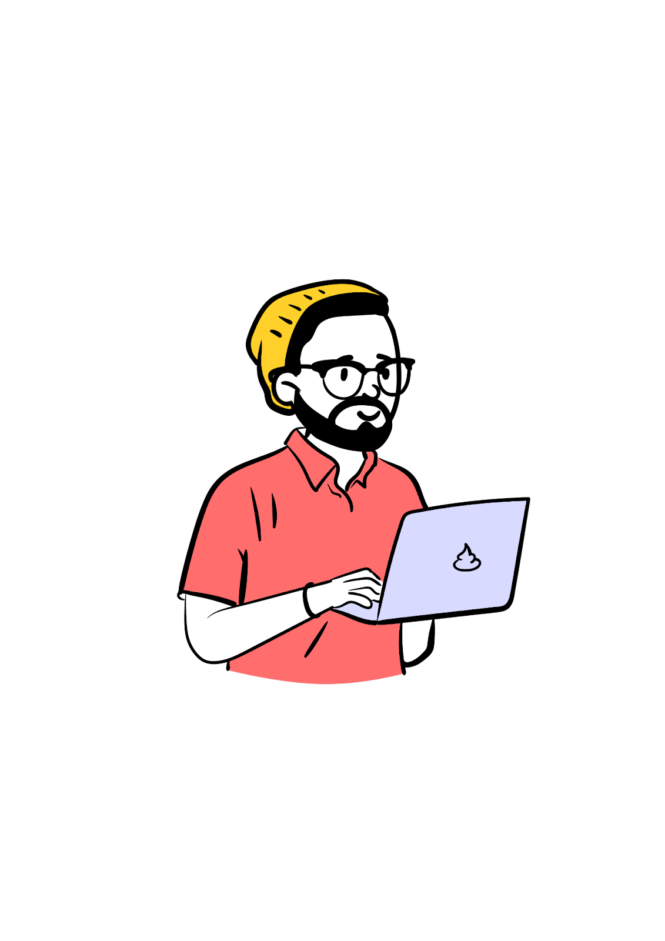
Developer ↮ Code
culture
Peer/mob
KISS
agile
CI/CD
SLA
DRY
methodology
hosting
monitoring
Best
practices
collaboration
UI
Clean
code
Happy Customer
DX
lean
User
driven
security
TDD
learning
Happy Users
Auto tests
UX
Database
SOLID
Programming language
professionalism
refactoring
Design patterns
architecture
OOP

Slide 5
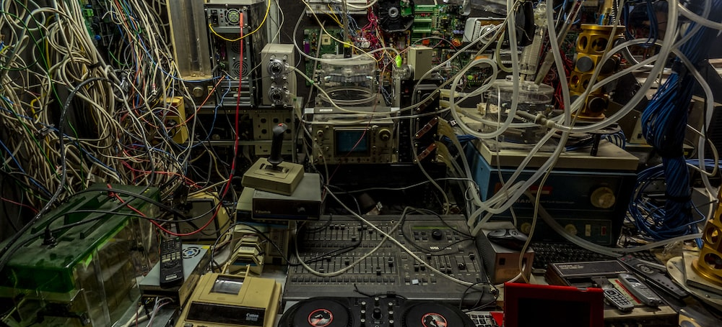
Flatsharing
Notes:
https://unsplash.com/photos/4h0HqC3K4-c

Slide 6





Craftsmanship in a nutshell
Clean code
Design Patterns
Collaboration
Testing
Learning

Slide 7
The multiverse of acronyms
KISS Keep It Simple Stupid
DRY Don’t Repeat Yourself
YAGNI You Ain’t Gonna Need It
DIE Duplication Is Evil
OOP Object Oriented Principles
SOLID
SRP Single Responsibility Principle
OCP Open/Closed Principle
LSP Liskov Substitution Principle
ISP Interface Segregation Principle
DIP Dependency Inversion Principle
ASMM And So Much More !

Slide 8

Well-crafted software
Not only working software, but also well-crafted software Well-crafted == high quality code
Automated tests
Business language in the code
Appropriate design
Code quality is not guarantee of success
but can be the main cause of failure

Slide 9

Steadily adding value
Not only responding to change, but also steadily adding value constantly improve your code
Testable
Extendable
Refactoring
Boy scout rule always leave the campground cleaner than you found it

Slide 10

Community of professionals
Not only individuals and interactions, but also a community of professionals share / mentor
Knowledge
Ideas
Successes & failures
Craftsman want to work with passionate and inspiring professionals

Slide 11

Productive partnerships
Not only customer collaboration, but also productive partnerships we are not factory workers
Must help our clients / users
Must be able to say no for clients goods
Some clients are not ready harder to manage

Slide 12
Manifesto for Software Craftsmanship
Raising the bar.
As aspiring Software Craftsmen we are raising the bar of professional software development by practicing it and helping others learn the craft. Through this work we have come to value
Not only working software, but also well-crafted software
Not only responding to change but also steadily adding value
Not only individuals and interactions, but also a community of professionals
Not only customer collaboration, but also productive partnerships
That is, in pursuit of the items on the left we have found the items on the right to be indispensable.
Notes:
http://manifesto.softwarecraftsmanship.org/#/en

Slide 13
Developer eXperience
Challenges
Technical
Bugs
Technical debt
Coding practices
Working with others
Conflict management
Opinions
Teamwork
Customer pressure
« for yesterday »
« Not working »
Low quality
Have an
IMPACT
Technical
achievements
Infinite source
for learning

Slide 14
Course focus
Code
Clean code
Test & refactoring
Best practices
Ways of working
Agility
Collective programming practices
Contexts
Embedded, desktop, on premise, cloud

Slide 15
Testing applications
End 2 end tests
Integration tests
Unit tests
Notes:
https://gist.github.com/cedrickchee/55ecfbaac643bf0c24da6874bf4feb08

Slide 16
Manual testing
Just do it…
…but actually don’t

Slide 17

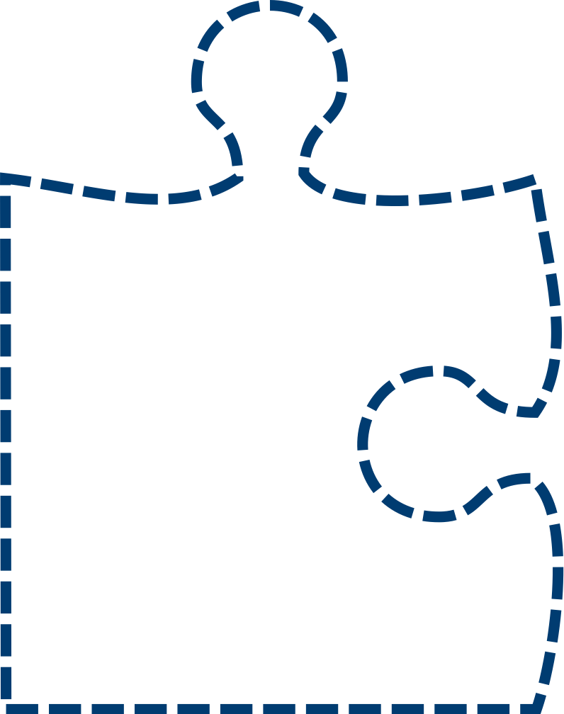

Unit test is a « code » specification
SUT System Under Test
Automated Tests brings confidence on code behavior
Code
+ Tests
Automated Tests act as specification
Potential bugs
Untold specifications
SUT
Specification
Spec changes
→ consequences
Code
+ no Tests
Wrong spec
→ wrong code

Slide 18
Assertion frameworks
assert.typeOf(foo, 'string’);
assert.equal(foo, 'bar’);
assert.lengthOf(foo, 3);
assert.lengthOf(beverages.tea, 3);
Different languages & frameworks → different opportunities
Technical Assertions
expect(foo).to.be.a('string’);
expect(foo).to.equal('bar’);
expect(foo).to.have.lengthOf(3);
expect(beverages).to.have.property('tea').with.lengthOf(3);
Behavior driven styles
Behavior focused DSL
Actual APIs depends on frameworks used
foo.should.be.a('string’);
foo.should.equal('bar’);
foo.should.have.lengthOf(3);
beverages.should.have.property('tea').with.lengthOf(3);

Slide 19






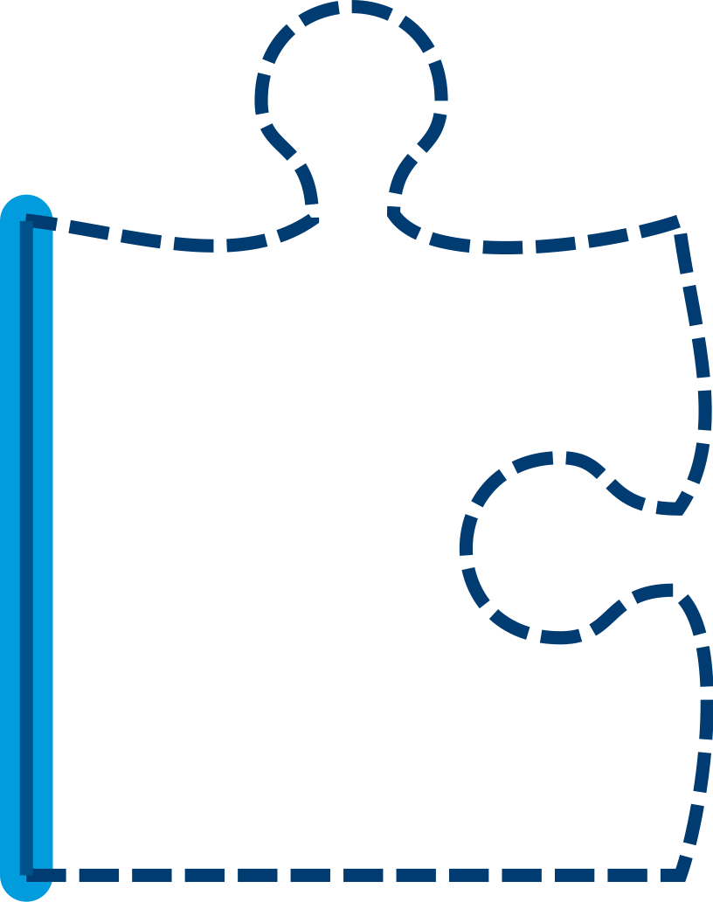



Code coverage
File count, functions, loc, branches
100%
80%
High coverage → less unplaned behaviors
50%
100% coverage is not 100% good
25%
0%
Aiming at 80% is Bu****it

Slide 20

Test doubles
Different types
Stub ~ simulates behavior
Mock ~ substitutes to objects
Spy ~ wraps real functions
Fake ~ working fake implementations
Dummy ~ needed but unused resources
Mocking/doubling is often a mix of those
Doubles are expensive
Contract holder ? SUT ? Double target ?
Challenge the need for doubles
Loose coupling
Minimize risks for future evolutions

Slide 21
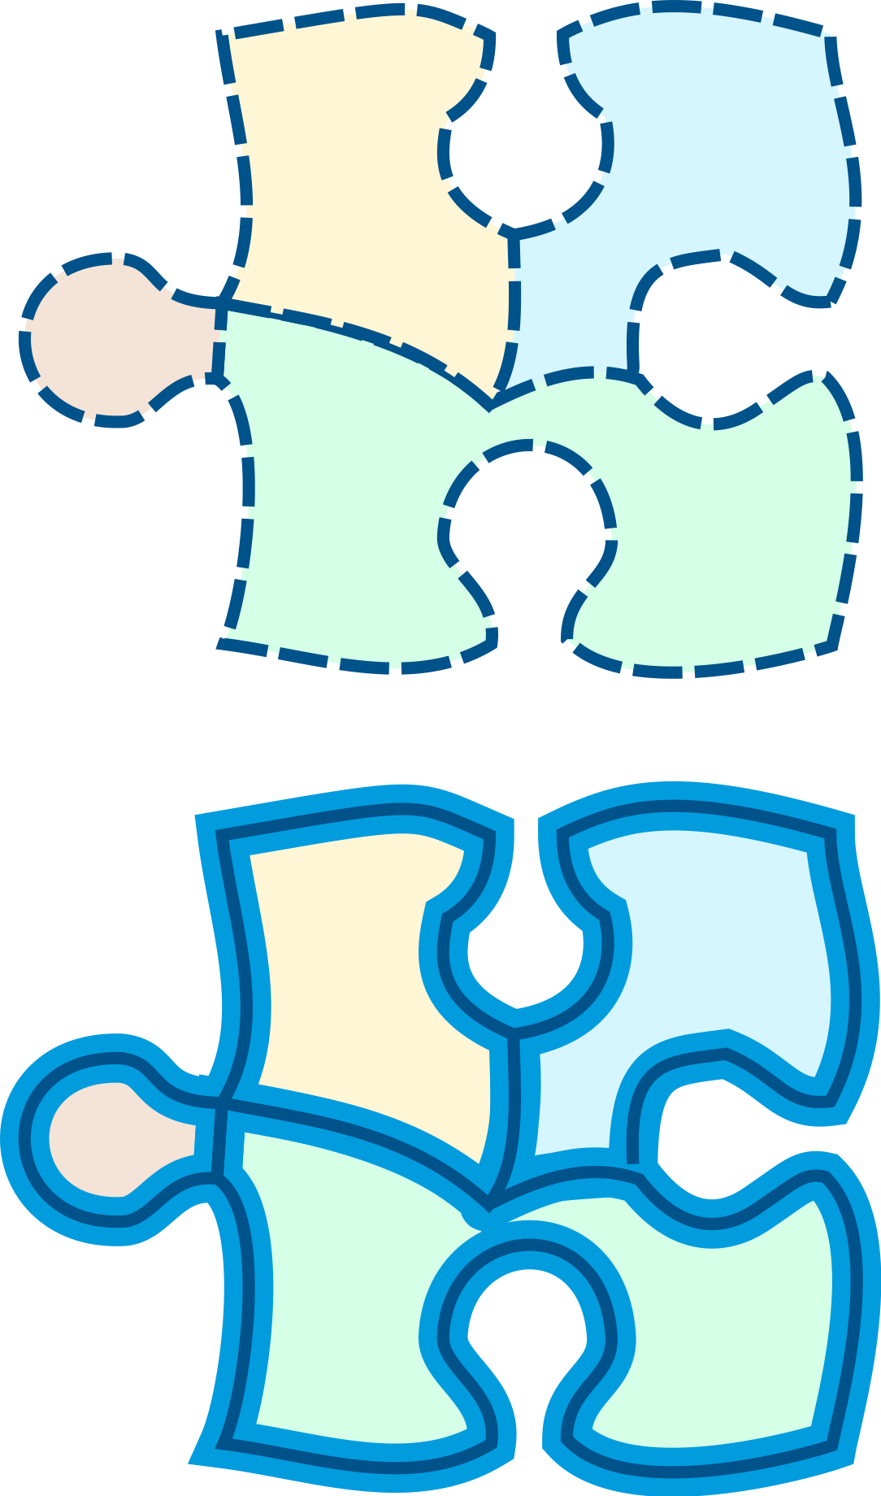

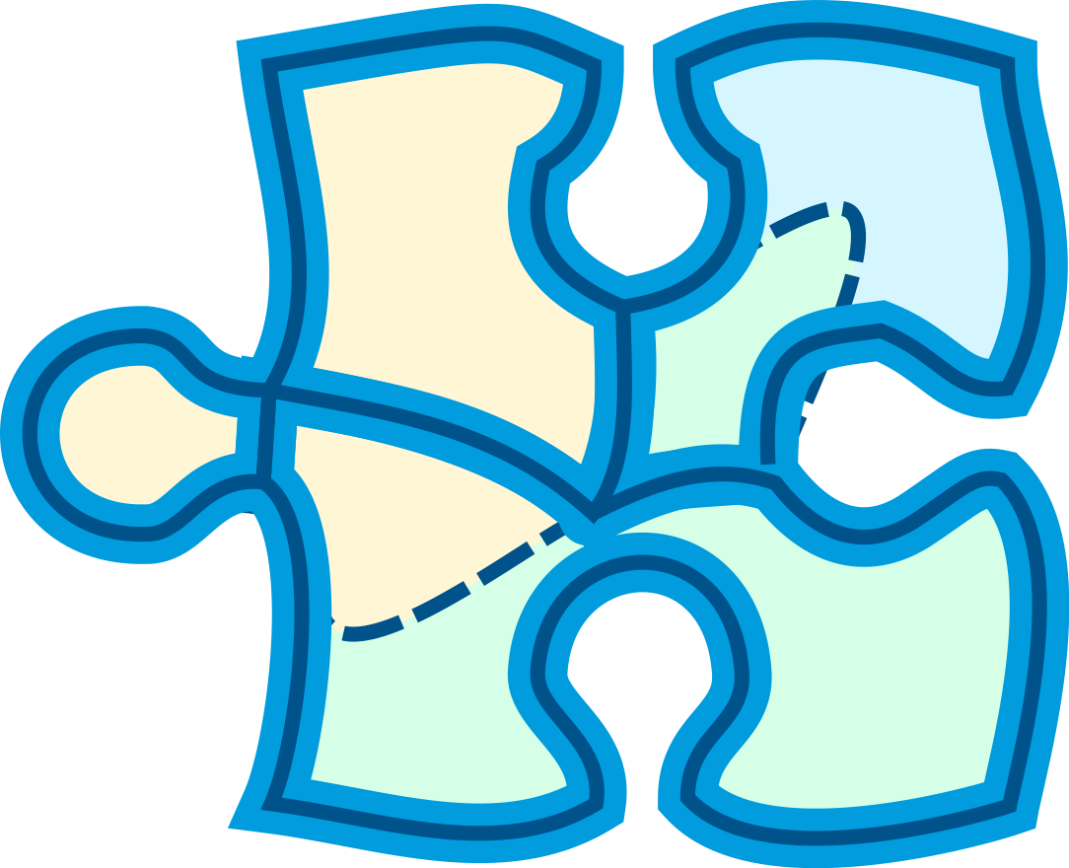
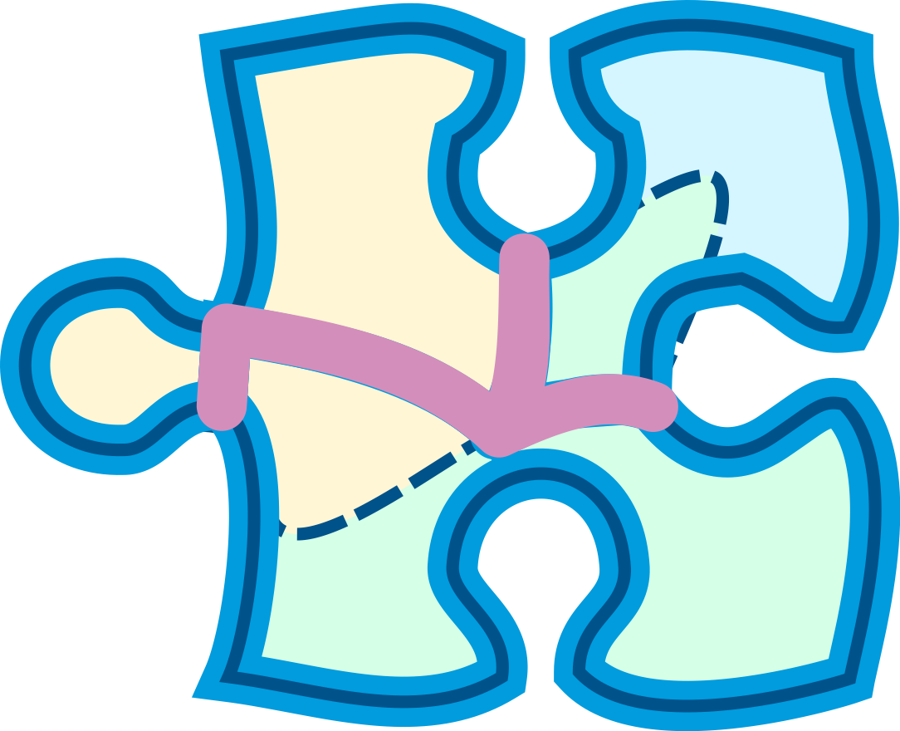
Testing private/internal organs
Testing private methods exposes them for potentially unwanted & unplanned usage
Testing internals limits refactoring ability
Focus should be on external behavior

Slide 22
TDD or not TDD
Don’t
E2e testing
Integration testing
Unit Testing
Do
E2e TDD
Integration TDD
Unit TDD
🤢 Your tests don’t actually test whay you think they test
When something can go wrong, it will go wrong
Your code design will suck
😀 Your tests expresses a contract
your tests validate expected behavior for sure
You will tend to have leaner and cleaner design

Slide 23
TDD Test Driven Development
Get higher confidence on test relevance
fail
correct
refactor
Enforce continuous refactoring
Focus on usage → loose coupling & lean code
Challenging techniques that helps designing sustainable code

Slide 24
TDD process
Write a test
Make it fail
Keep it simple
Test describe use case
Test describe technical spec
Clean up code
Keep test green
Change code, not behavior
Restructure one step after another
Get to green fast
Take baby steps
Stuck ? Undo & start over
Write only enough code to pass test
Don’t test external dependencies

Slide 25
Let’s code !
Example by code
fizzbuzz
String processing function (capitalize)

Slide 26
Just in case
One test ↔ 1 usecase ! 👩🏿‍🤝‍🧑🏻
🐾 Baby steps
Perf testing 😷

Slide 27
London vs. Chicago
Feature A
Feature A1
Feature A2
Inside out
Chicago
Outside in
London
Feature A1-1
Feature A1-2
+ of test doubles
Feature A1-1-1

Slide 28
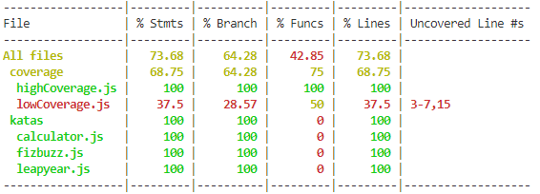
100% code cover-mir-age

Slide 29
ATDD Acceptance Test Driven Development
GIVEN a need for debugging specs
WHEN the 3 amigos align with the need
THEN there will be a shorter lead time
AND lower code rewrite
fail
Failing acceptance test
refactor
correct
It works !

Slide 30
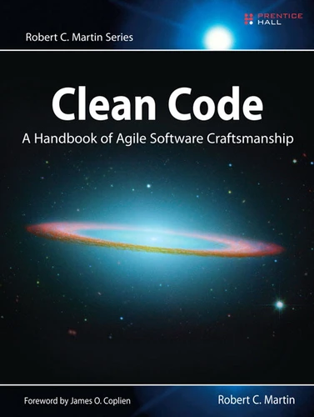
Clean Code fundamentals
https://gist.github.com/cedrickchee/55ecfbaac643bf0c24da6874bf4feb08
Notes:
https://gist.github.com/cedrickchee/55ecfbaac643bf0c24da6874bf4feb08

Slide 31
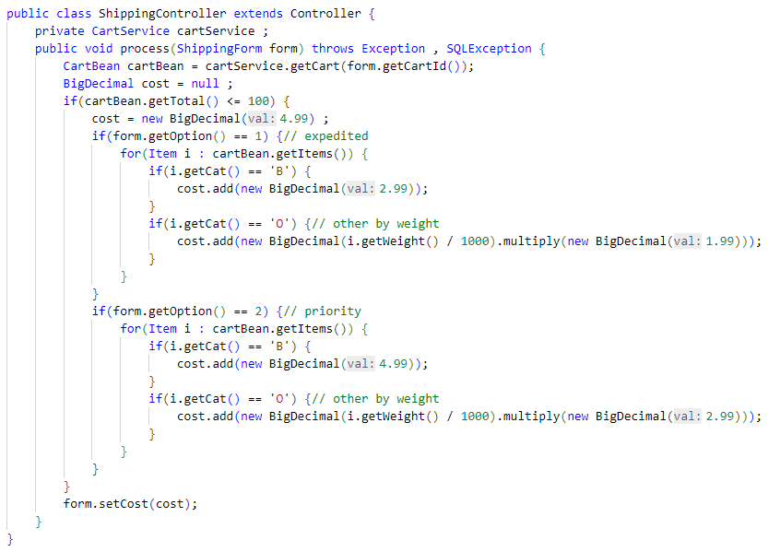
1 ↔ expedited ??
Magic Numbers ??
Copy paste (?)
B, O ??
Unit ?
Currency ?

Slide 32
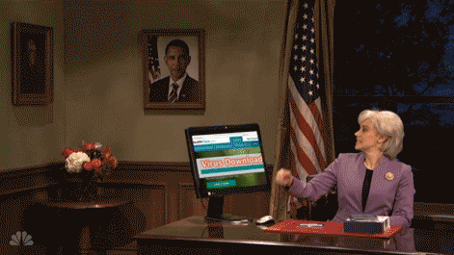
Clean code
Set of « best » practices or antipatterns avoidance
Technical design
Understandability
Naming
Function
Comments
Coding
Object oriented
Testing
Error handling
…

Slide 33
General Rules
Follow standard conventions
Work together
KISS
Simpler is always better – reduce complexity
Boy scout rule
Leave the place cleaner than you found it
Always find root cause
A problem’s cause is not always the one you see first
Follow the principle of least surprise
System should behave the way we expect them to – users are part of the system
DRY
Don’t repeat yourself
Do not override safeties
They exist for a reason

Slide 34
Design rules
Keep configurable data at high level
They should be easy to change
Prefer polymorphism
to if/else or switch/case
Separate multi-threading code
Prevent over-configurability
Use dependency injection
Follow law of demeter

Slide 35
Understandability
Be consistent
Whatever the way, stick with it
Use explanatory variables
Encapsulate boundary conditions
Prefer dedicated value objects
to primitive type
Avoid logical dependency
Prefer purity
Avoid negative conditionals

Slide 36
Names rules
Choose descriptive and unambiguous names
Make meaningful distinction
Use pronounceable names
Use searchable names
Replace magic numbers with named constants
Avoid encodings
Don’t append prefixes or type information

Slide 37
Functions rule
Keep them small
Do one thing
And do it well
Use descriptive names
Prefer fewer arguments
≤ 3 arguments
Have no side effects
Don’t use flag arguments
Split method into several independent methods

Slide 38
Comment rules
Always try to explain with code
Not with comments
Don’t be redundant
i++; // increment i 😫
Don’t add obvious noise
Don’t use closing brace comments
E.g. // end of function
Don’t comment out code
Just remove it
Use as explanation of intent
Use as clarification of code
Use as warning of consequence

Slide 39
Source code structure
Separate concepts vertically
Related code should appear vertically dense
Declare variables close to their usage
Dependent functions should be close
Similar functions should be close
Place functions in the downward direction
Keep lines short
Don’t huse horizontal alignment
Use white space to associate related thing and disassociate weakly related
Don’t break indentation

Slide 40
Objects and data structures
Hide internal structure
Prefer data structure
Avoid hybrids structures
Should be small
Do one thing
Small number of instance variables
Base class should know nothing of their derivatives
Better to have many functions than to pass some code into function to select a behavior
Prefer non-static methods to static methods

Slide 41
Tests
One assert per test
Fast
Independent
Repeatable
self-validating
Timely
Readable
Easy to run
Use a coverage tool

Slide 42
TDD
Write test and code together
You may not write production code until you have written a failing unit test
You may not write more of a unit test than is sufficient to fail (including compilation errors)
You may not write production code that is sufficient to pass the currently failing test

Slide 43
Code smells
Rigidity
Software difficult to change; a small change causes a cascade of subsequent changes
Fragility
The software breaks in many places due to a single change
Immobility
You cannot reuse part of the code in other projects becose of involved risks and high effort
Needless complexity
Needless repetition
Opacity
The code is hard to understand

Slide 44
Error handling
Don’t mix error handling and code
Use exceptions instead of returning error codes
Don’t return null
Don’t pass null either
Throw exceptions with context

Slide 45
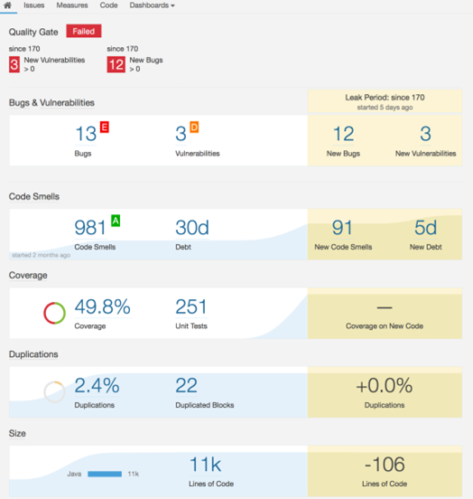
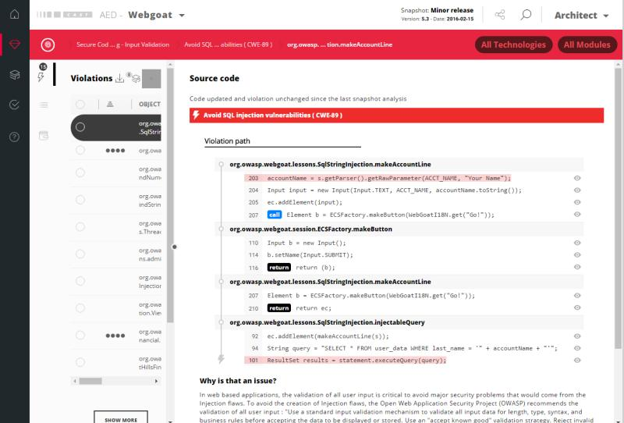
Technical debt
Everything that breaks your productivity
wrong technical designs, little tests, code readability, bugs, crappy doc, process mess, fuzzy requirements, high lead time, …

Slide 46
Pictures comes from unsplash.com
Avatars from open peeps flat assets
Manifesto for software craftsmanship http://manifesto.softwarecraftsmanship.org/#/en
https://github.com/fmbenhassine/awesome-software-craftsmanship

